Slide 1
Chicago Crime
By
Stephen Bowman, Josh Griggs, Benjamin Sauceda,
Shivani Singh, Scarlett Winters

Slide 2

Data Sets Analyzed
2018 Chicago Crime Data
data.cityofchicago.org/Public-Safety/Crimes-2018/3i3m-jwuy
Local Weather Data
www.ncdc.noaa.gov
Notes:
Crime-
Date occured
Primary type (theft/batter),
Description (simple battery, retail theft)
(hierarchical- only charged with most serious crime an aggravated domestic battery offender would not also be charged with domestic and simple battery. Additionally if an offender committed a lesser offense in the commission of
a crime only the most serious offense would be listed here. All other lesser offenses would only be found in a case report)
location (residence, gangway),
domestic or not,
community area,
ward,
police locations (district, beat, etc)
Weather
Date (our joining factor)
Station
Snowdepth
Precipitation
Tavg
Tmax
Tmin
Windspeed
Wind temperature
(wind speed not consisten trhoughout the city)

Slide 3
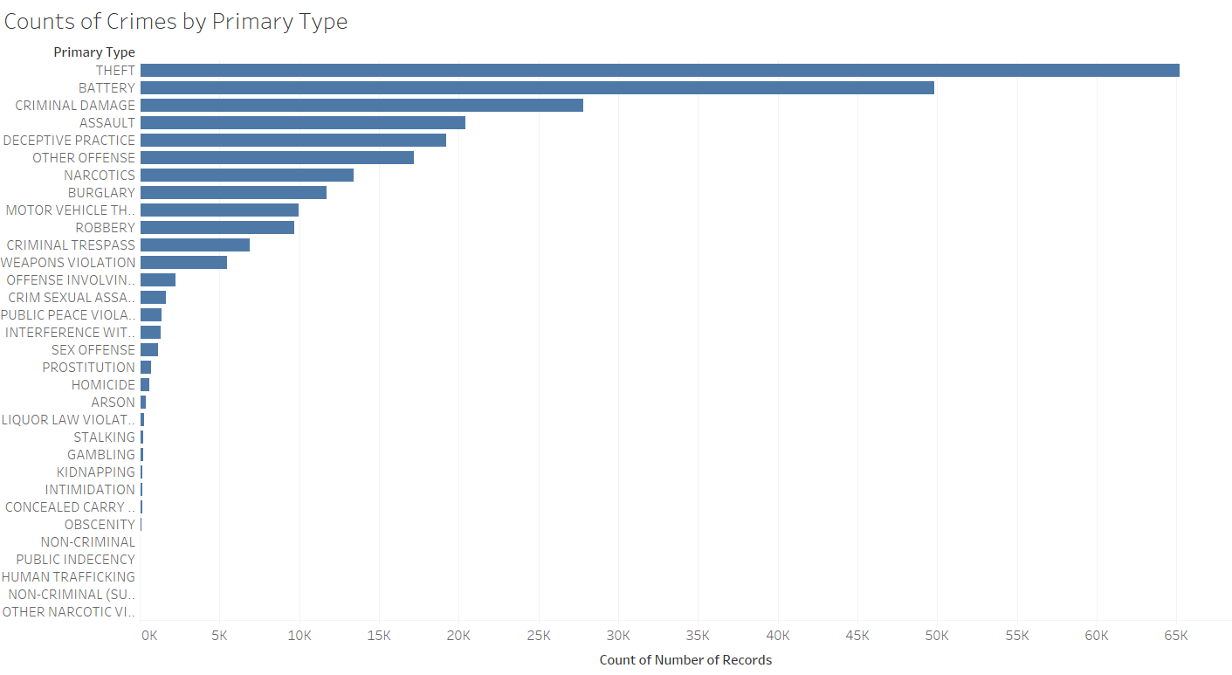
Why Analyze Theft and Battery Arrests?
In 2018, theft and battery were the two most common crimes, and accounted for 42.99% of all crime committed in Chicago.
Theft and battery are not restricted by location.
Not every theft or battery resulted in an arrest (20.58% of battery, 9.71% of theft)
Notes:
Battery Ranges from Simple Battery (a misdemeanor) to more serious charges like Aggravated Batttery Hand gun (explain various upgraded charges)
Theft (not motor vehicle theft, separate charge) . All felony charges except controlled substance charges need to be approved by states attorneys. This meets there maybe have been instances that have occured that may have met criteria for felony charges, but were not charged as such.

Slide 4
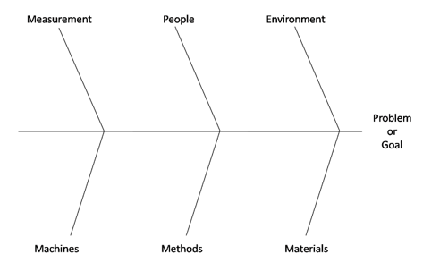
What Impacts Crime and Arrest Rates in Chicago?
Measurement
People
Mother Nature
Season
Temperature
Wind Speed
Shift of the Day
Precipitation
Season
Holidays
Used only one year’s data
Shift of the Day
Wind Speed
Events in the City
No. of Personnel per Shift
Precipitation
Rain
Snow
Theft
And
Battery
Temperature
Lack of Education
Weapon
Police Response Time
Community Areas
Assault by other items
Resources Available to the Police
Assault without weapon or item
Holiday
Socio Economic Factors
Methods
Materials

Slide 5
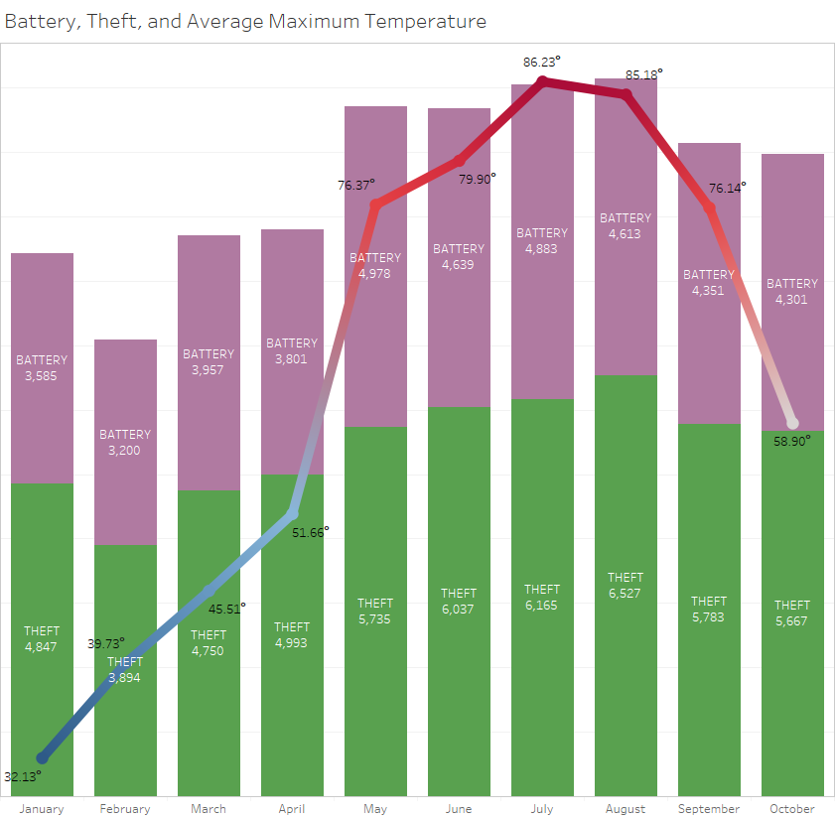
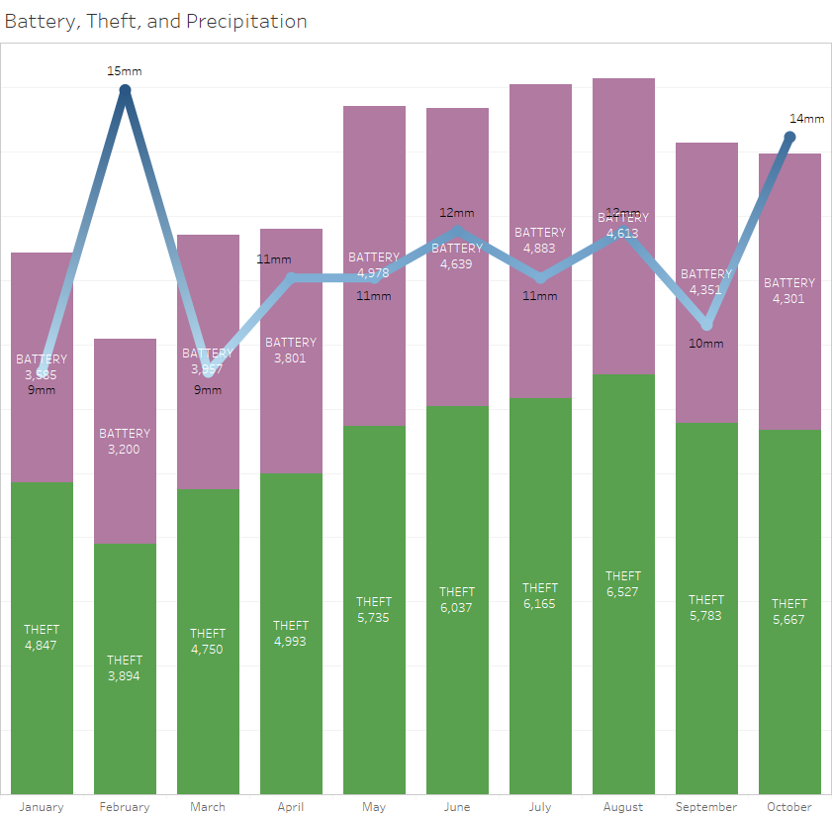
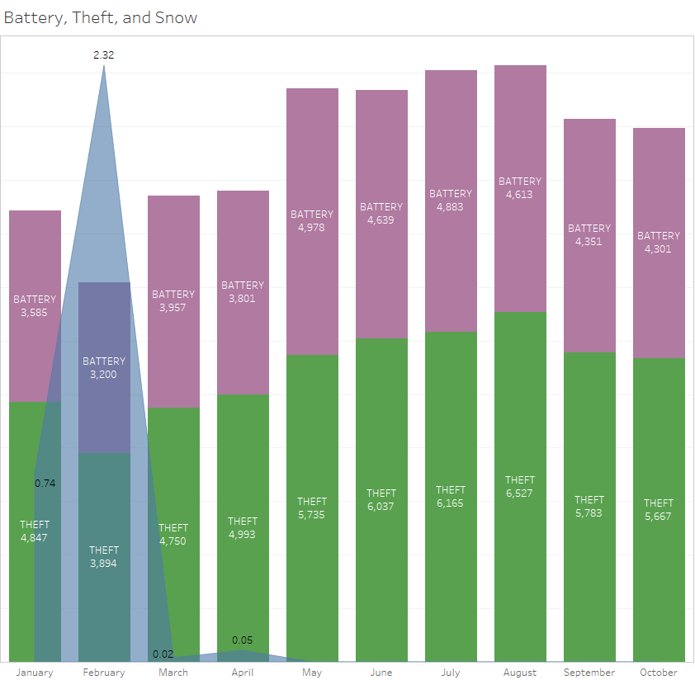
Identified Factors for Crime
Temperature
Precipitation
Snow

Slide 6
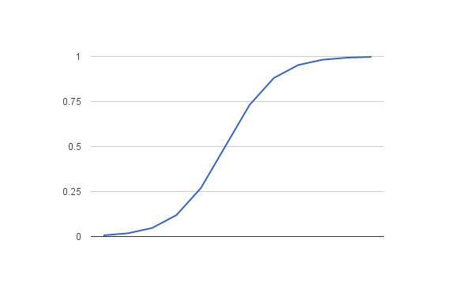
Prediction Methodology
Logistic regression → binary classification question on non-linear data (y/n arrest)
Used L2 regularization (Ridge) - Did not use feature selection
Stratified k-fold cross-validation (k=5)
Ran models on x’s across weather, shift, season & combined
No log loss greater than 0.50
All models experience similar IS and OOS log losses
Theft models yielded lower LL (~0.31 IS and OOS)
Notes:
0.50 and below log loss = average to good. Scale is 0 to 1 with 0 being best. L1 (Lasso) and L2 (Ridge) are used to regularize parameters and filter out non-important features as they get pushed to 0. All L1 and L2 do is determine method to select which features get regularized. We chose L2 because we had a smaller pool of features and did not need model to select for us via L1

Slide 7

Arrests: What did our Analysis Tell Us? (Weather)
Battery Theft
Precipitation Decrease Decrease
Snow depth Increase Increase
Snowfall Decrease Increase
Avg. temp. Increase Decrease
Avg. wind speed Increase Decrease

Slide 8

Arrests: What did our Analysis Tell Us? (Time)
Battery Theft
Holiday Increase Increase
Winter/Spring Increase Increase
Summer/Fall Decrease Decrease
12am-8am Increase Decrease
8am-4pm Decrease Increase
4pm-12am Decrease Increase

Slide 9

Potential Big Data Pitfalls
Removing collinear temperature variables (min/max temp)
Removing crimes and fields that would introduce noise (zip codes, map coordinates)
Notes:
Remove crimes (identity theft and credit card fraud)
Remove fields like historical area, zip codes, map coordinates.
All felony charges except controlled substance charges need to be approved by states attorneys. This meets there maybe have been instances that have occurred that may have met criteria for felony charges, but were not charged as such.
Felony charges* require State’s Attorney Approval (crimes may have occurred but not charged)
*For all crimes OTHER than charges relating to a controlled substance

Slide 10

Additional Data to Enhance the Model
Data on large events
Weather data for a full year
Expand crime data to more years
Notes:
Data on large events happening in Chicago. An increased number of people in the city, but also an increase in active duty police officers around the events.

Slide 11

Recommendations
Consider weather trends when planning out city-wide crime prevention programs. Tailor crime prevention programs to seasonal activity.
Bring in more NOAA data to continue studying weather’s relationship with crime

